Slide 1
R605 EEG Device Instructions

Slide 2
The Amplifier

Slide 4
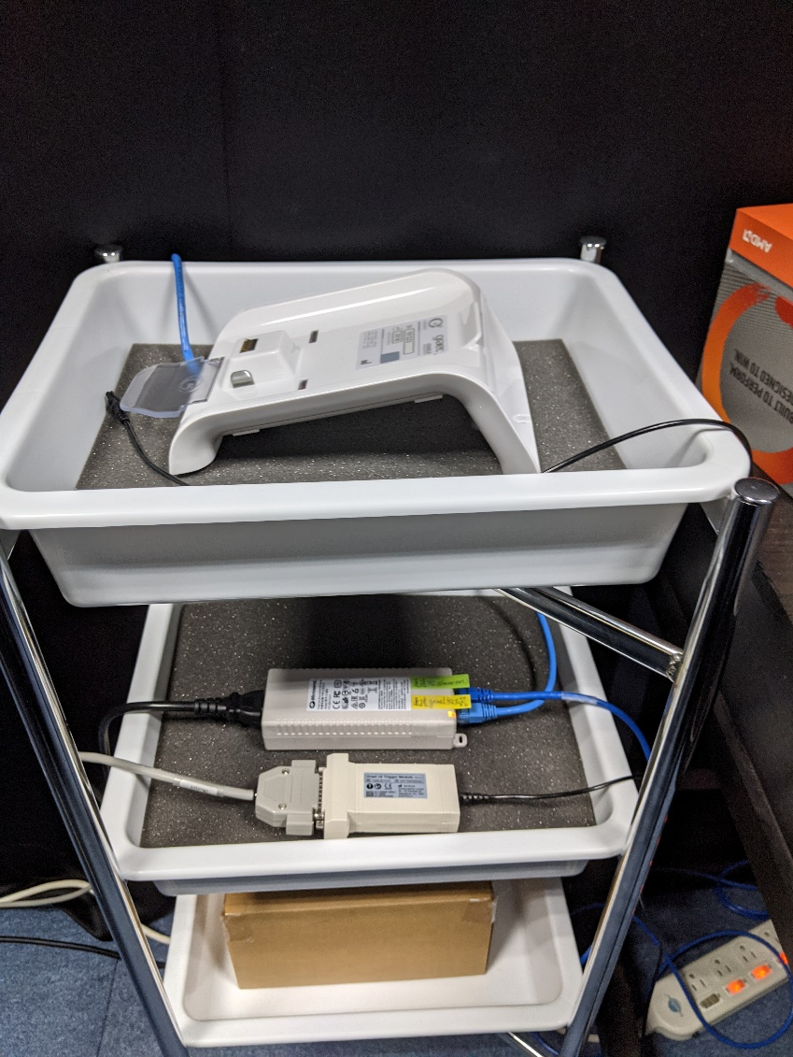
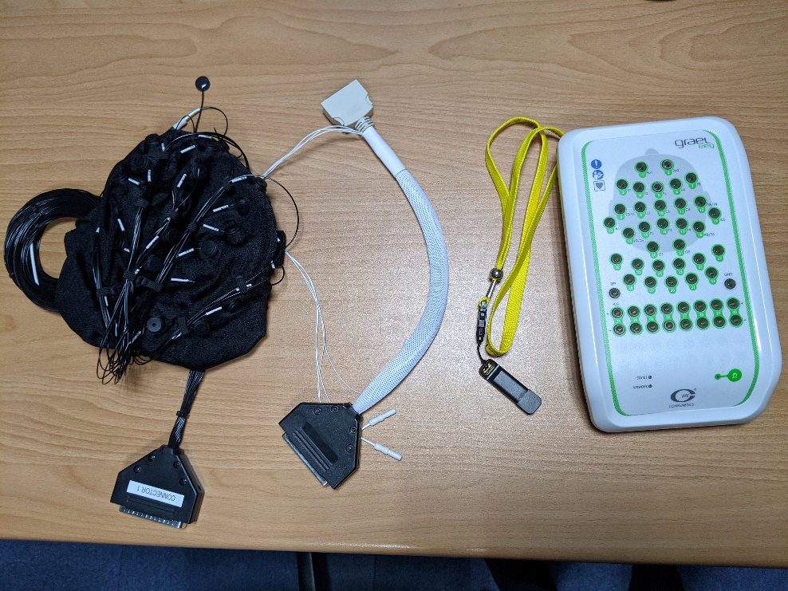
Accessories
Electrode Caps (32 channels) x4
Electrode Cap Adapter x2
Dongle for Recording x1
Amplifiers x2
Headbox base x2
Trigger connection set x2

Slide 5
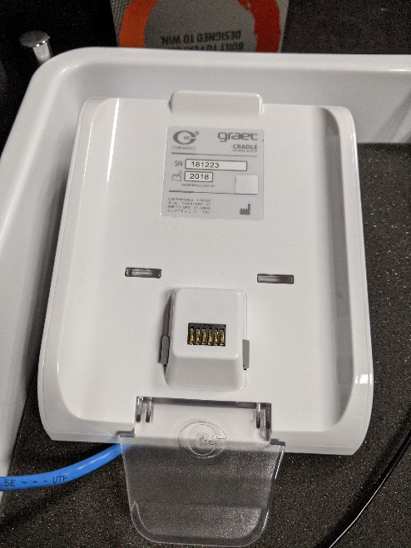
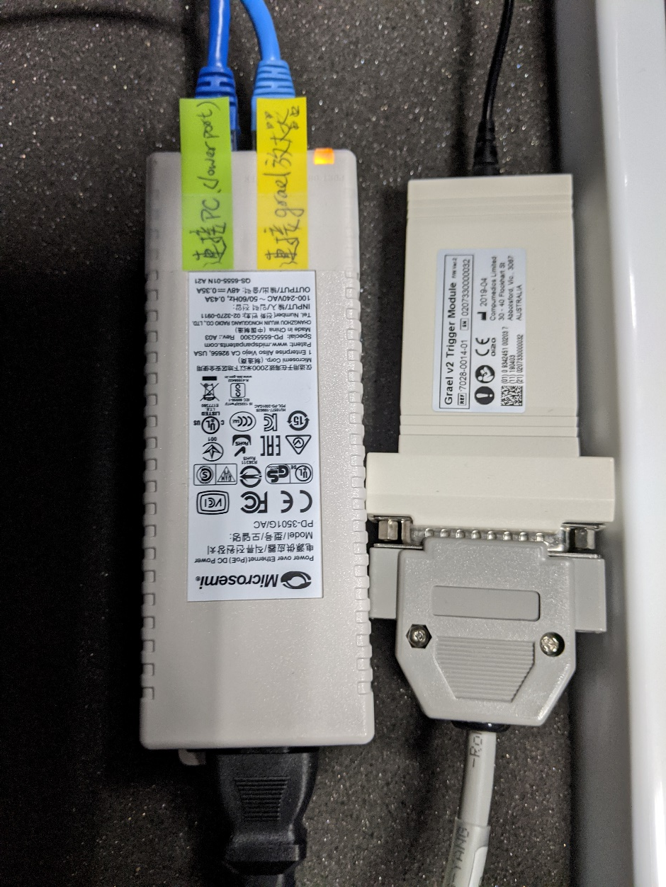
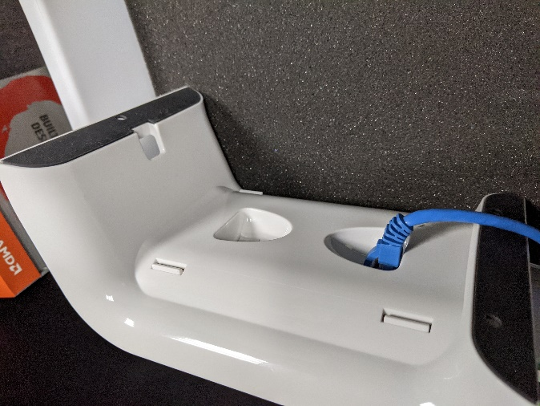
Connecting the Base and Signal Cables

Slide 6
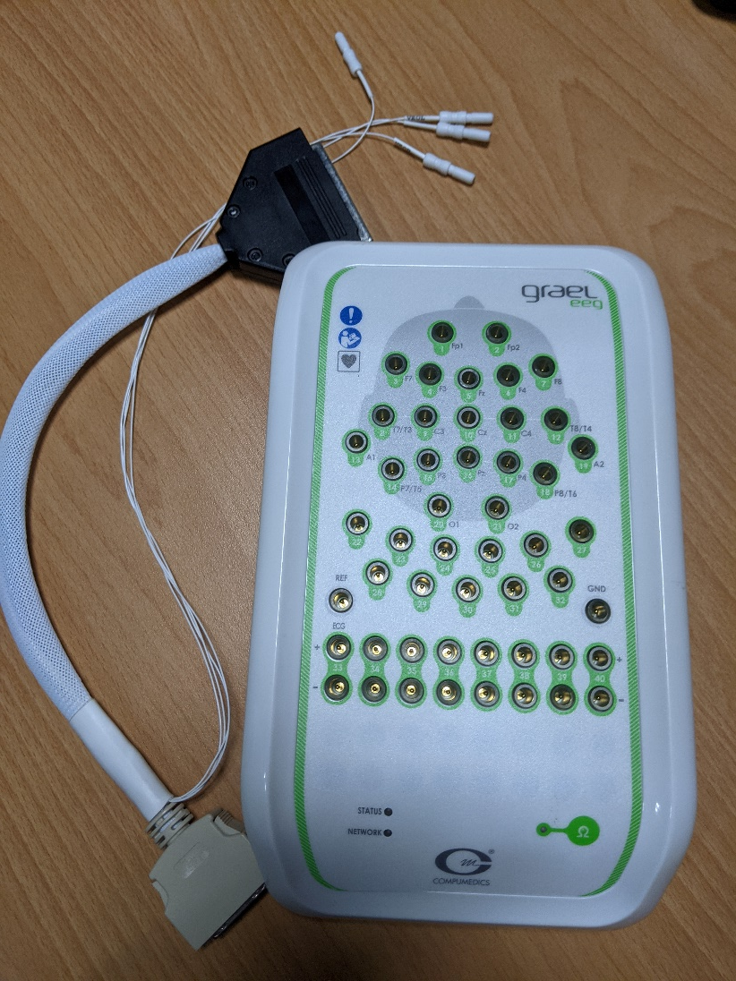
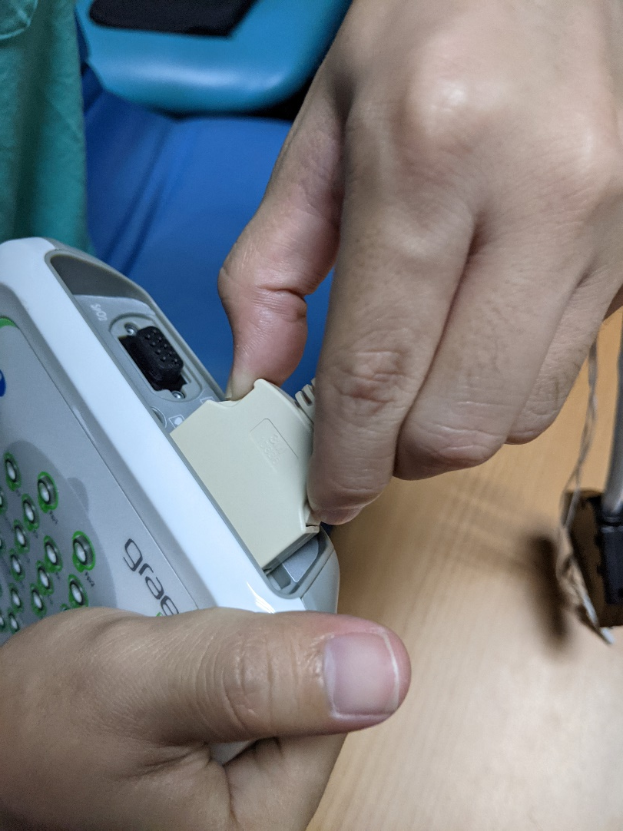
Connect the adapter to the Headbox

Slide 7
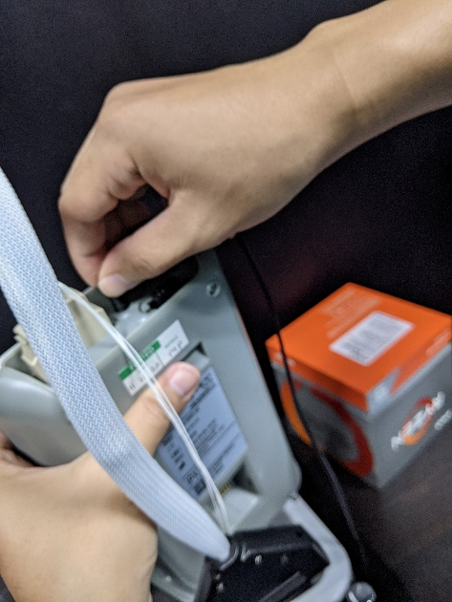

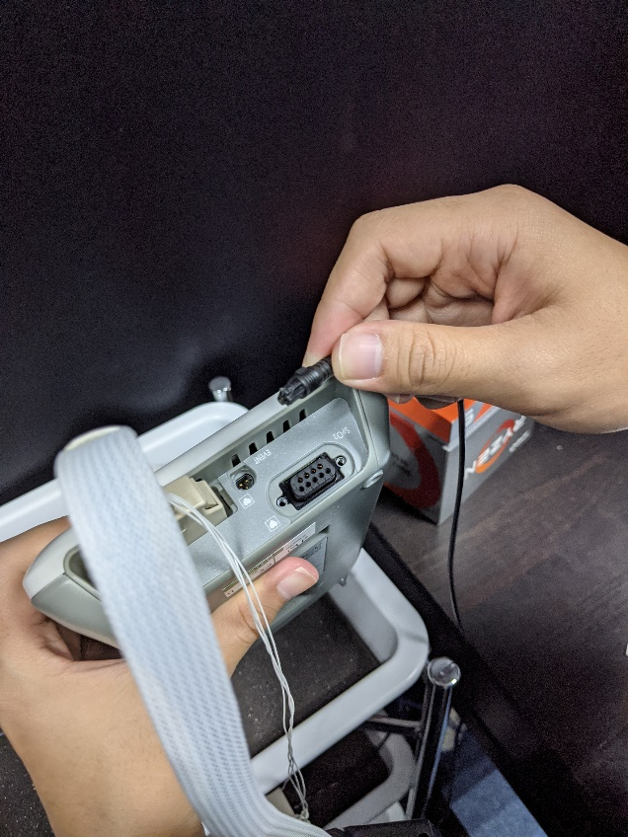
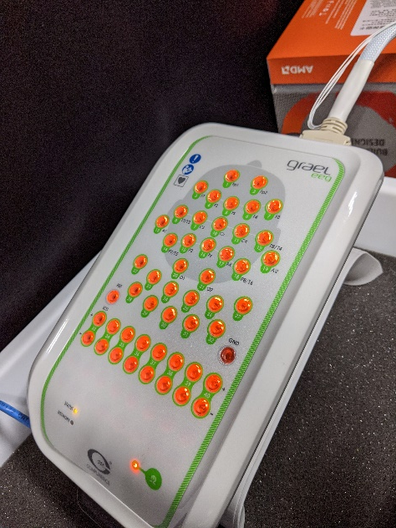
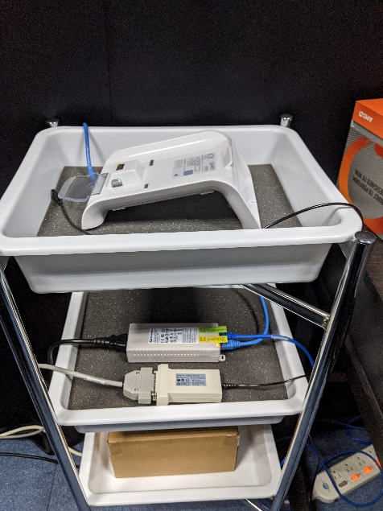
Connect the Headbox to the base
Once connected correctly, the light will turn on

Slide 8
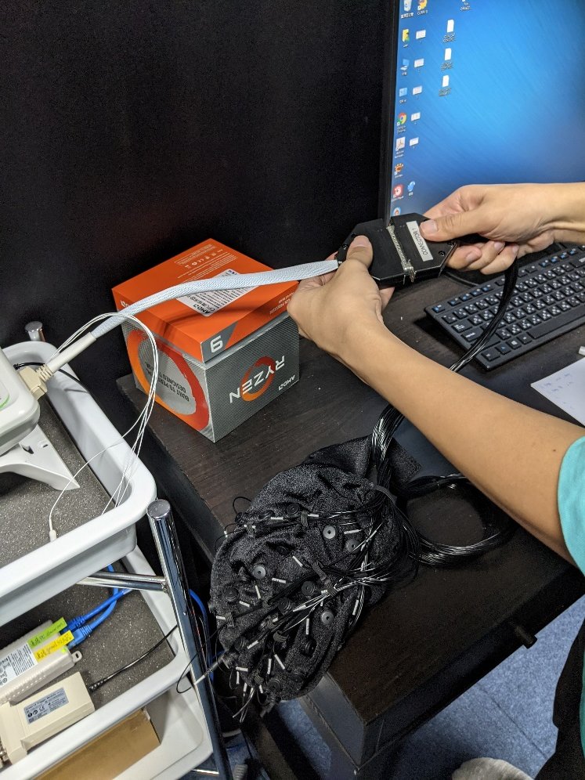
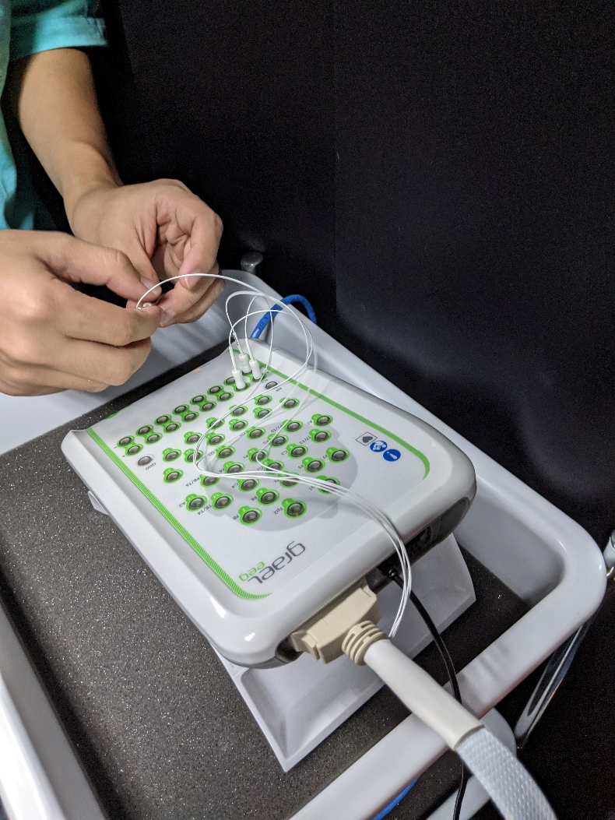
Connecting the Electrode Cap and Bipolar Channels (EOG)

Slide 9
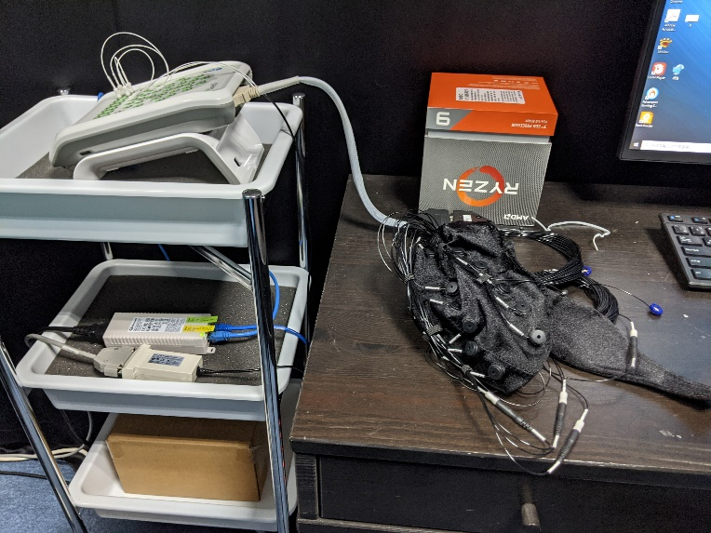
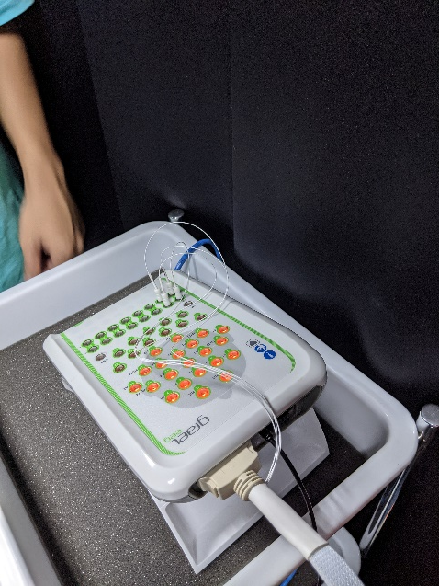
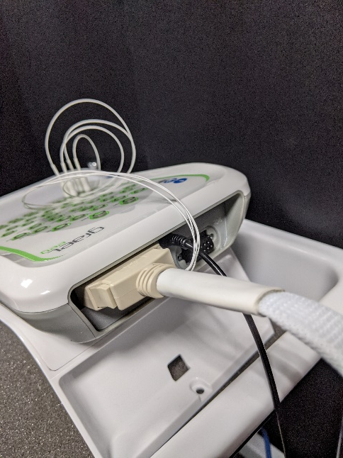
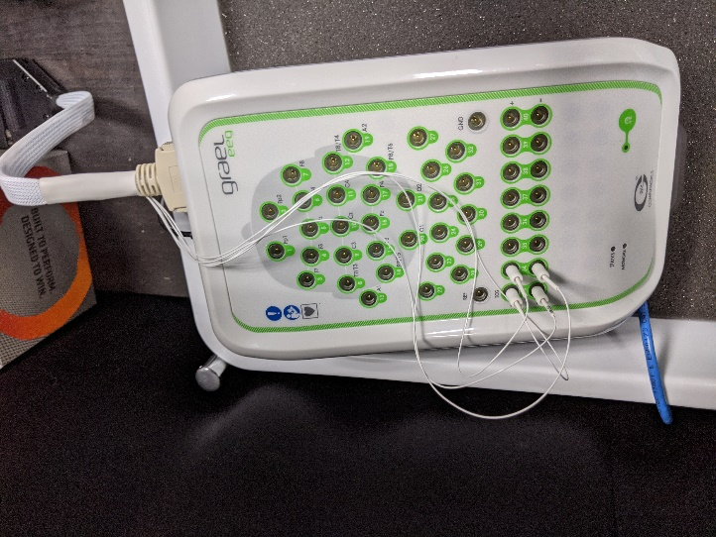
The connection is complete, proceed to the PC.

Slide 10
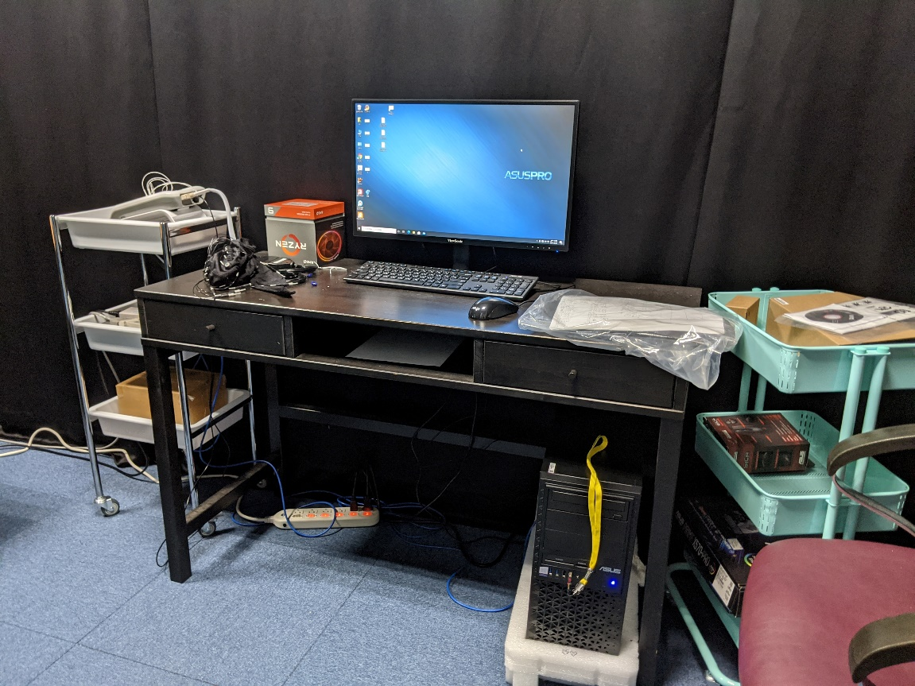
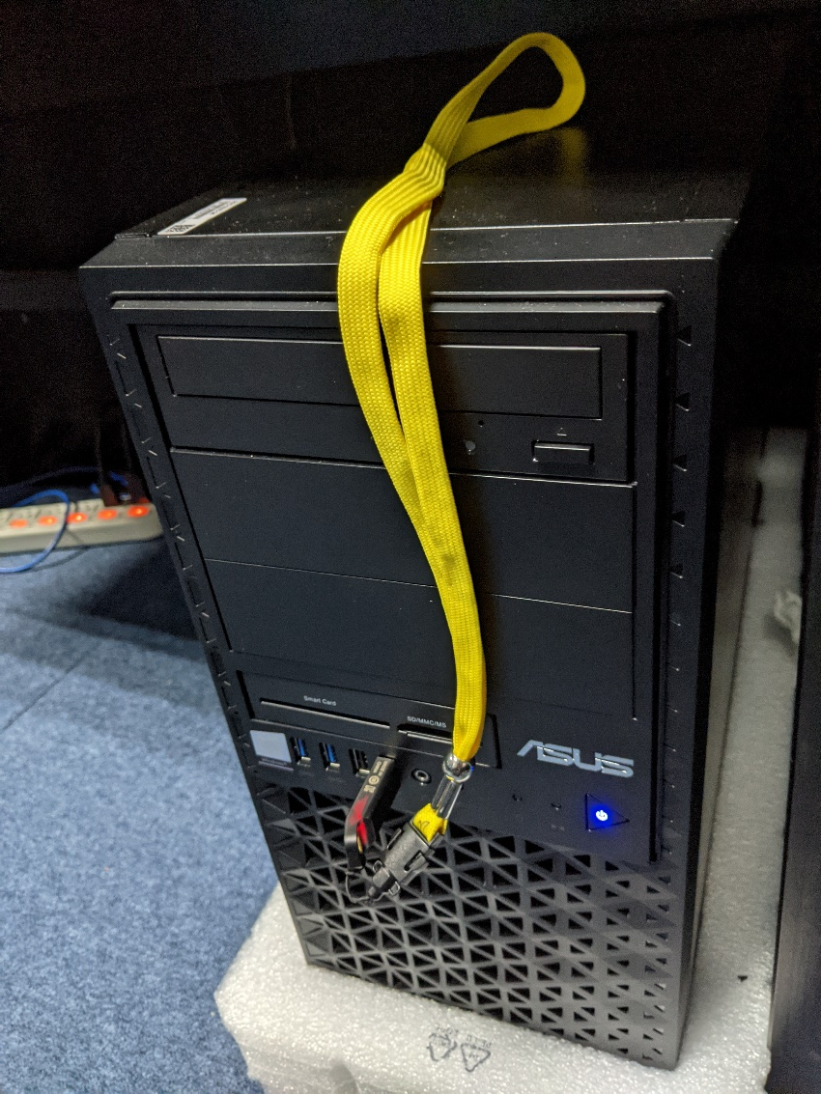
Inserting the dongle

Slide 11
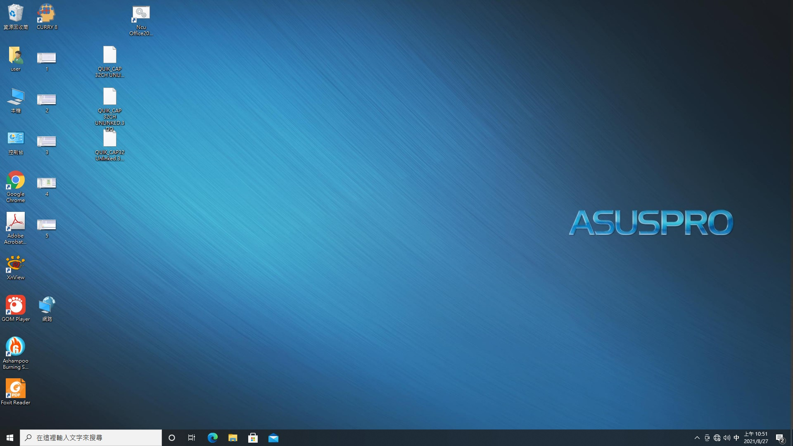
Launch the recording software

Slide 12
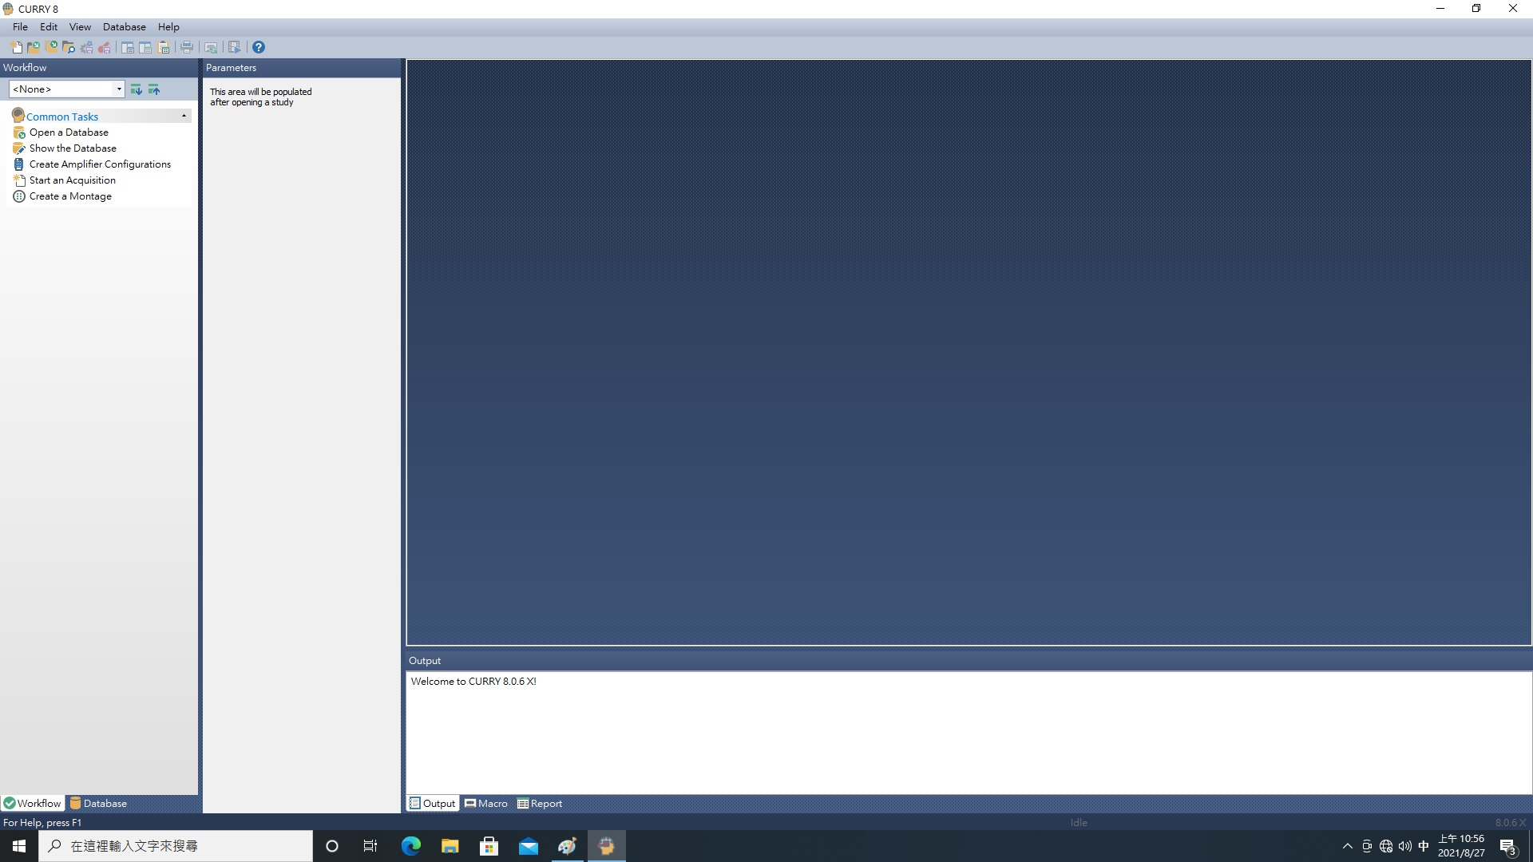
Launch the recording software

Slide 13

Create a new (or load an old) study

Slide 14
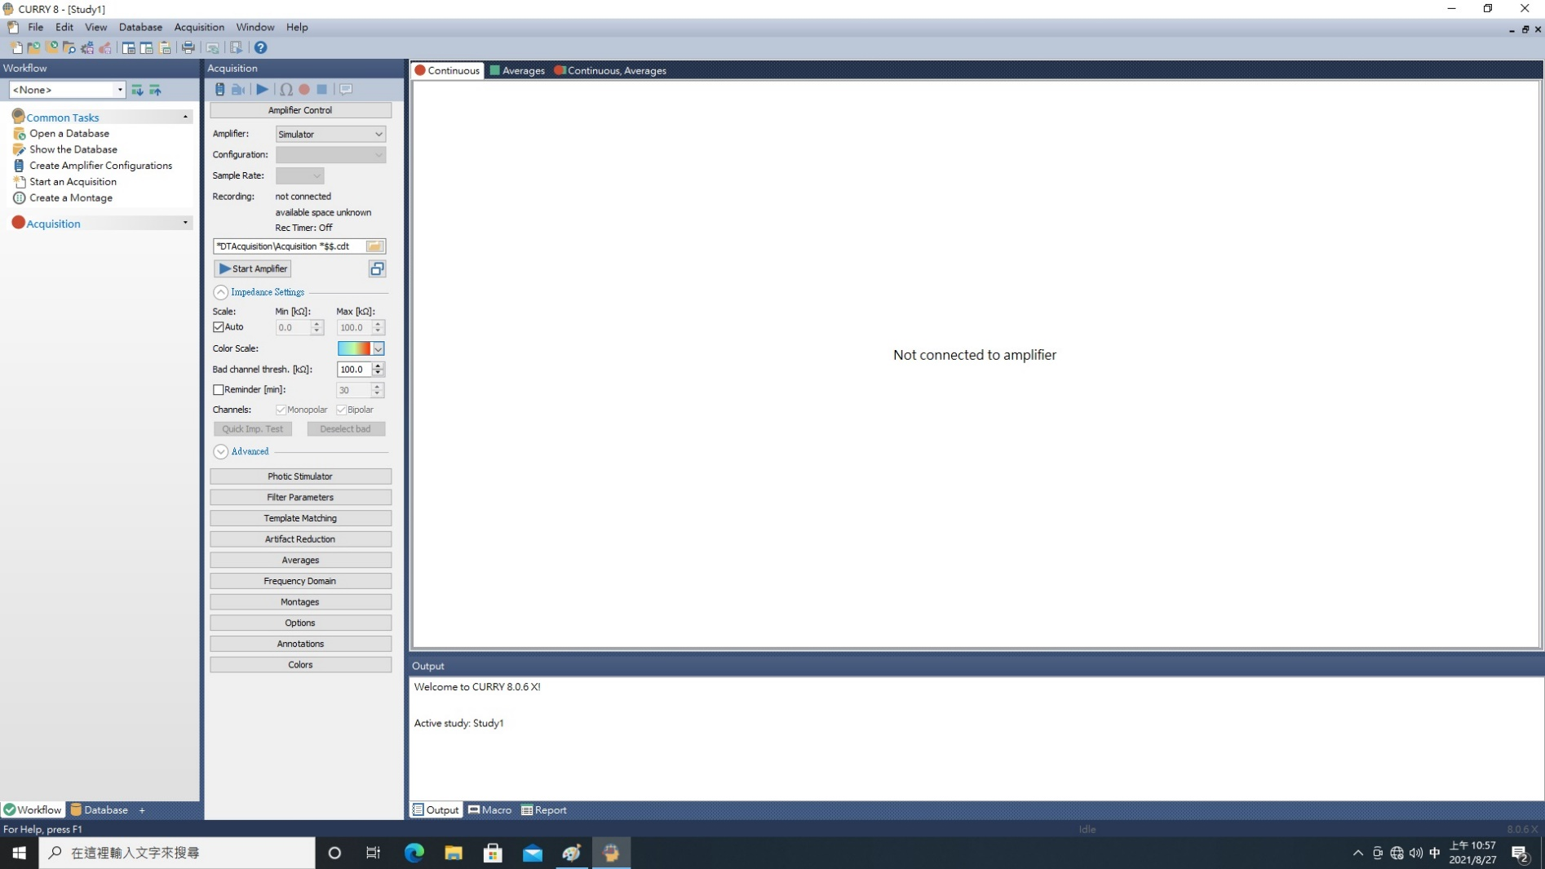
Create a new (or load an old) study

Slide 15
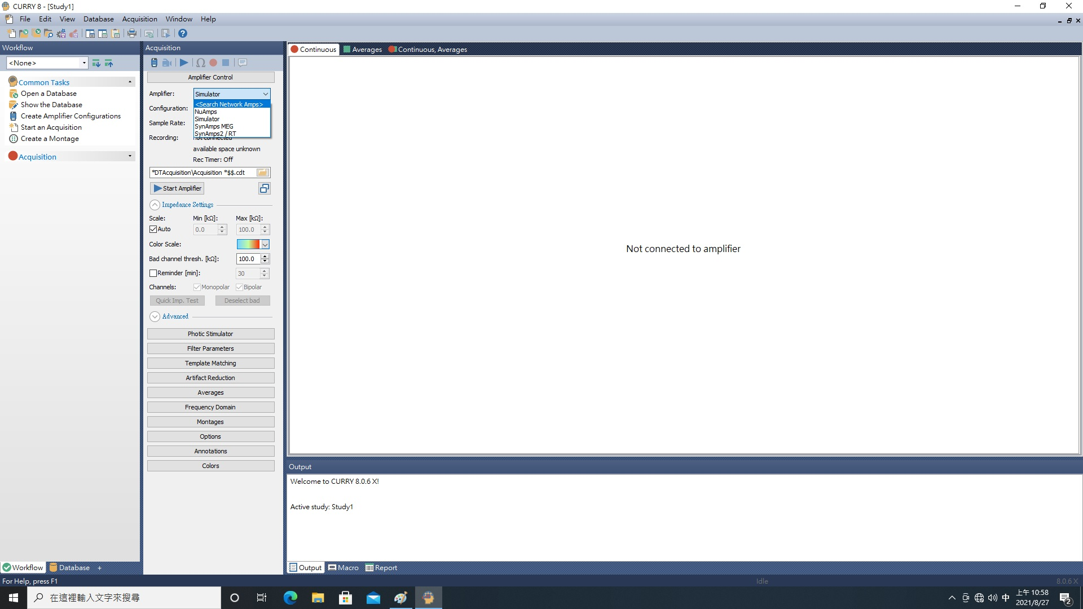
Connect to the amplifier via the network.
Note: It may take a few attempts to establish the connection

Slide 16
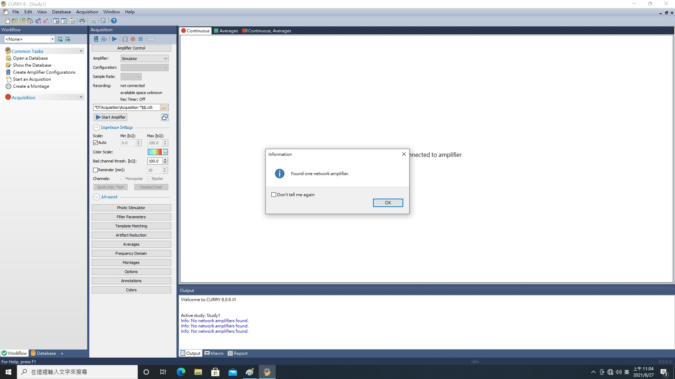
Connect to the amplifier via the network.
Note: It may take a few attempts to establish the connection

Slide 17
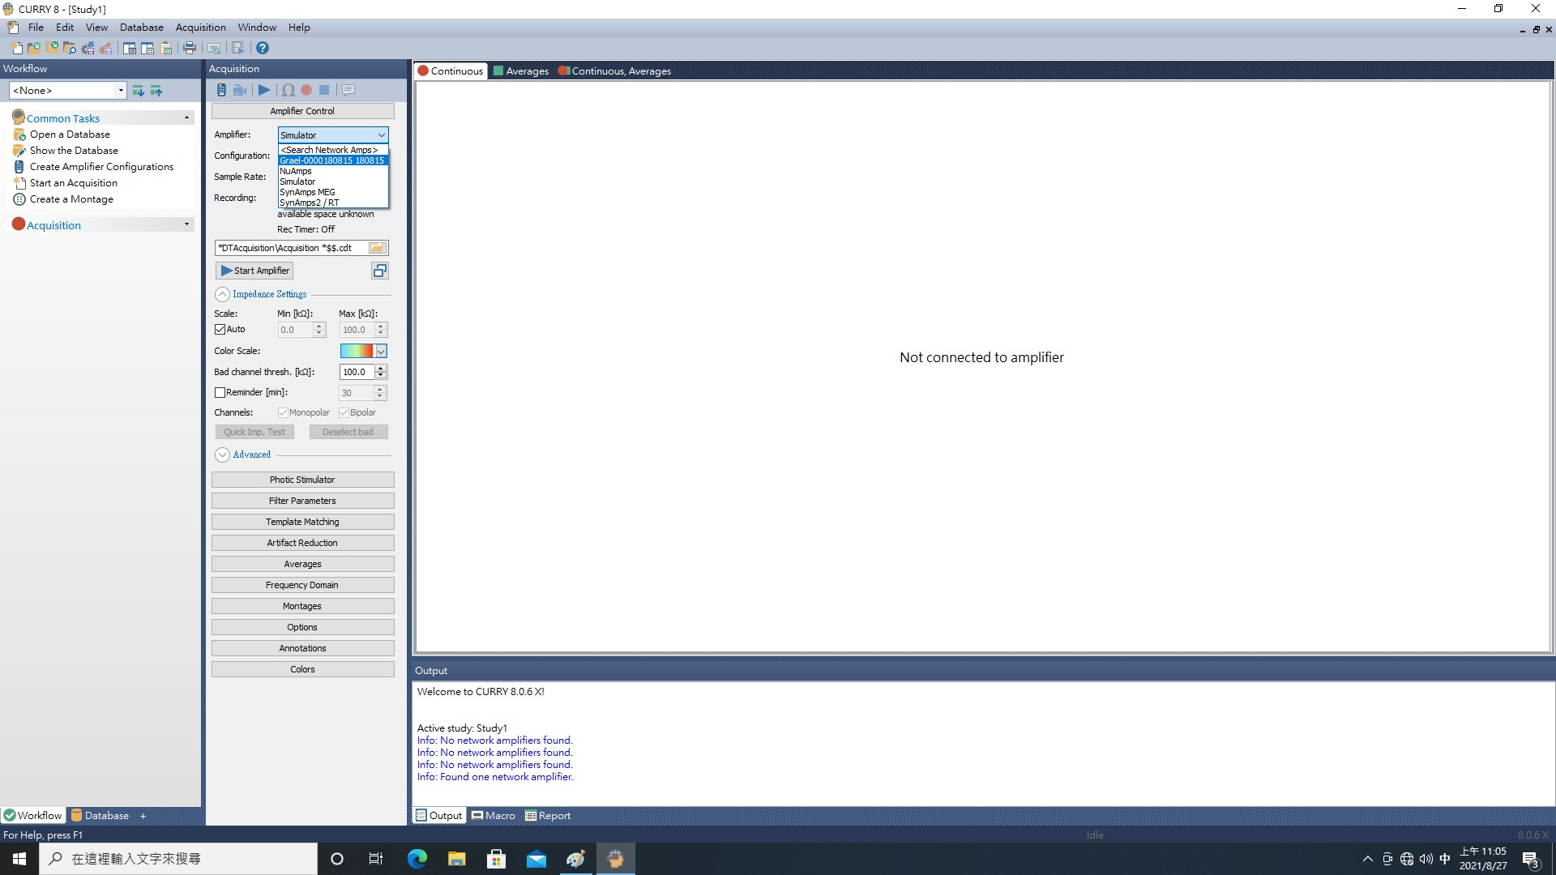
Selecting the amplifier

Slide 18
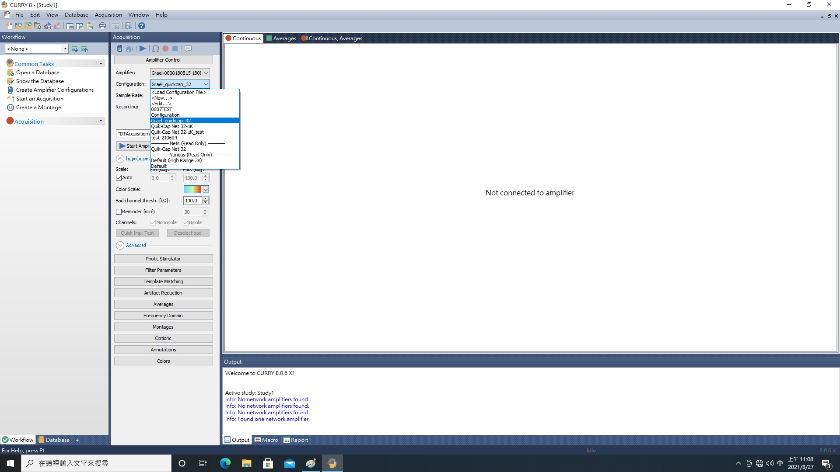
Choose the appropriate configuration file based on the study requirements.

Slide 19
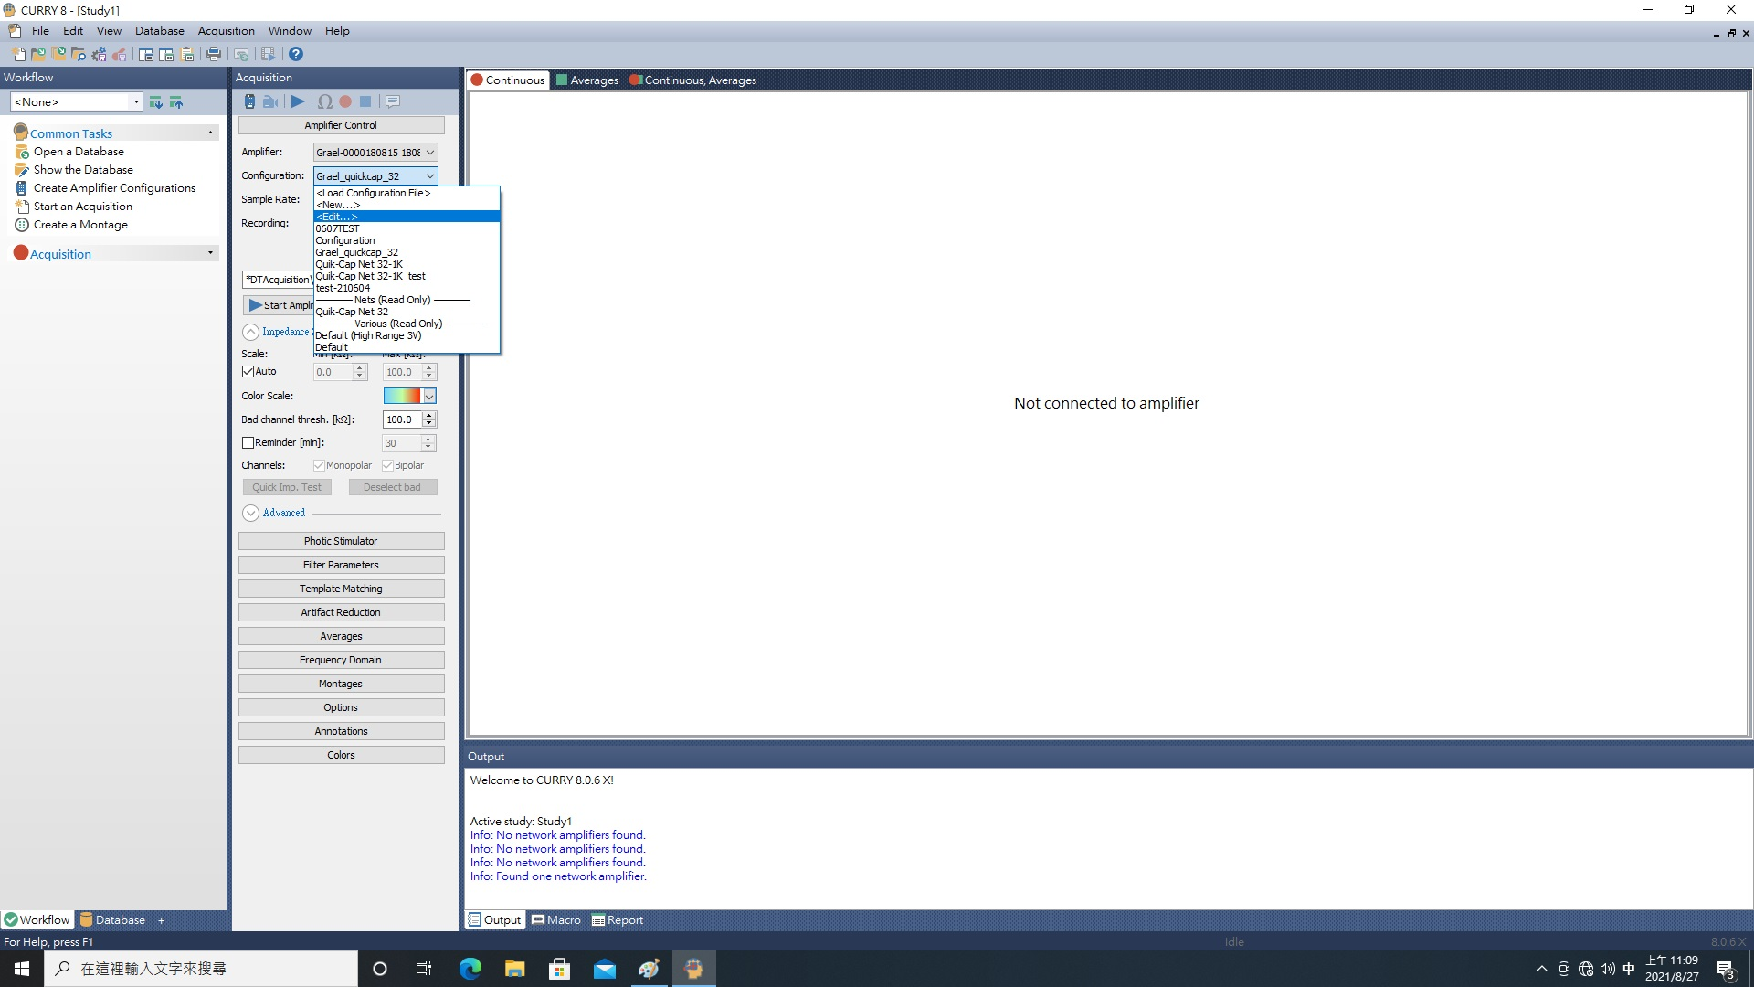
Adjust the recording parameters to fit the study's needs, including the sampling rate and signal filters

Slide 20
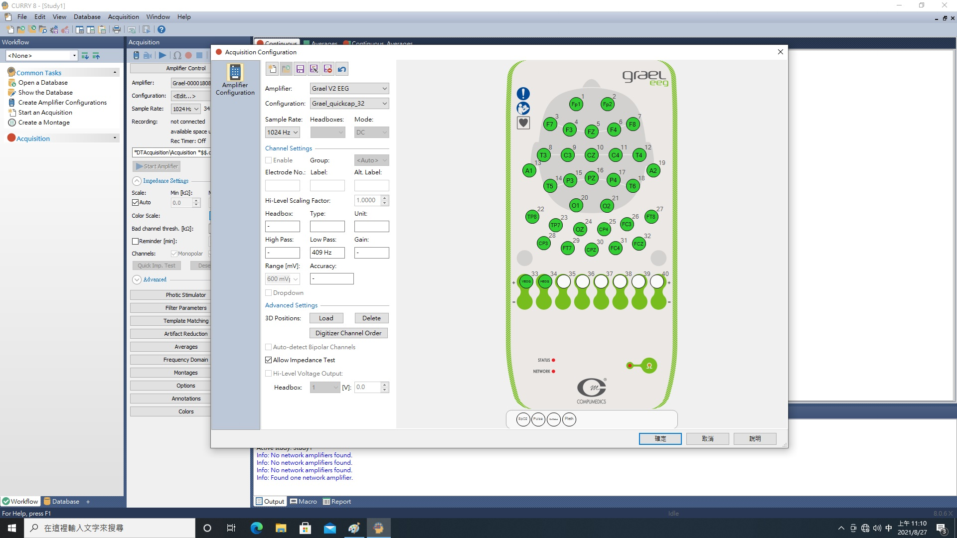
Adjust the recording parameters to fit the study's needs, including the sampling rate and signal filters

Slide 21
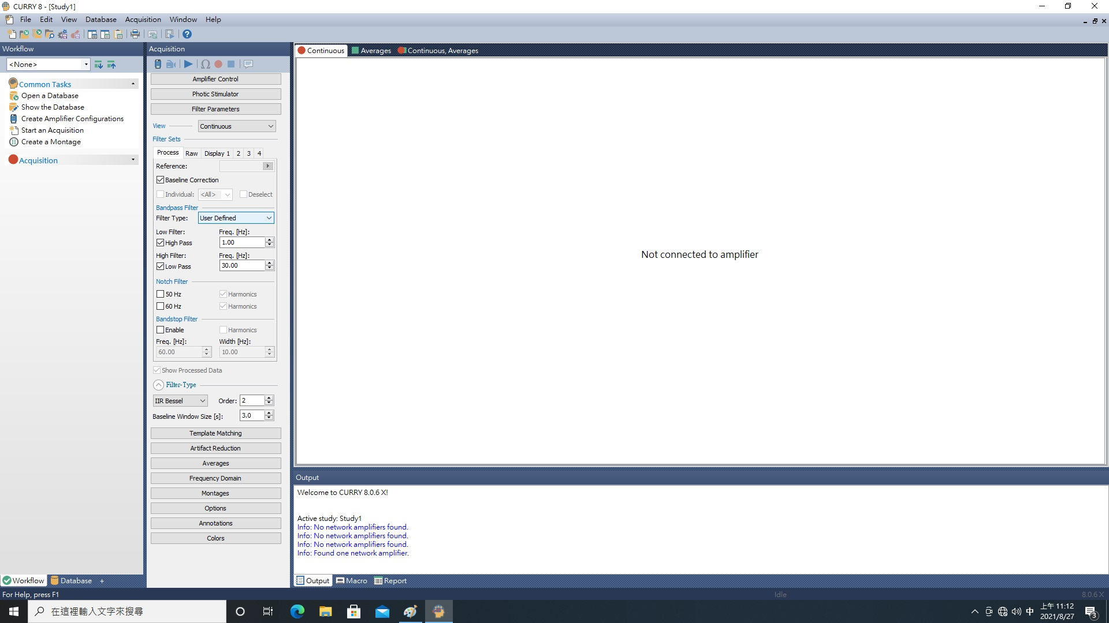
Adjust the recording parameters to fit the study's needs, including the sampling rate and signal filters

Slide 22
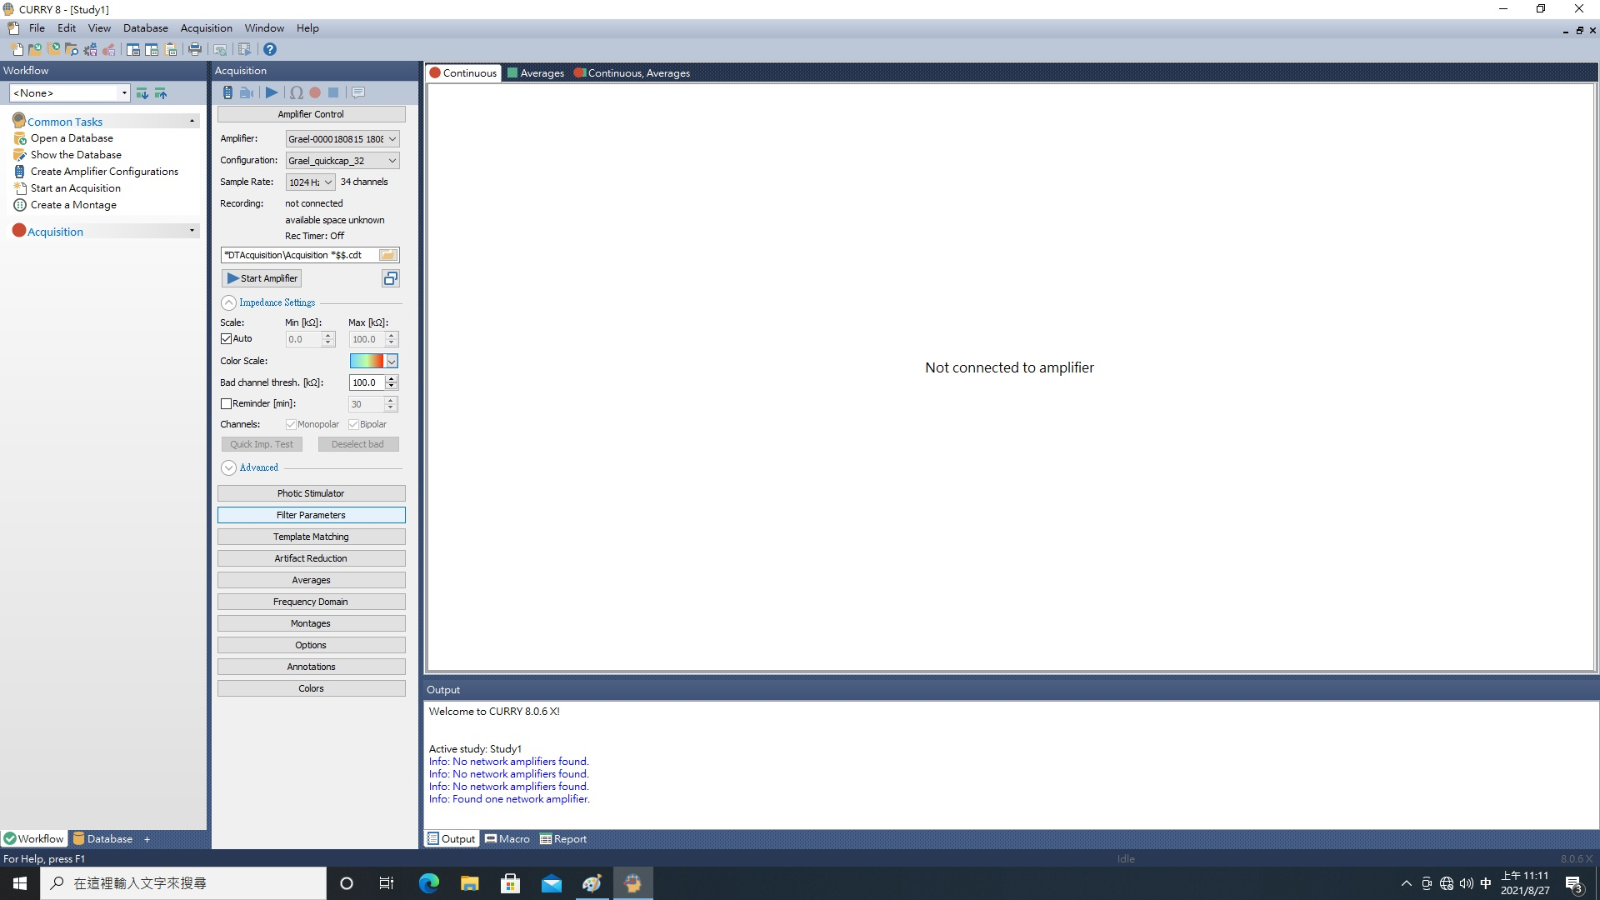
設定記錄參數

Slide 23
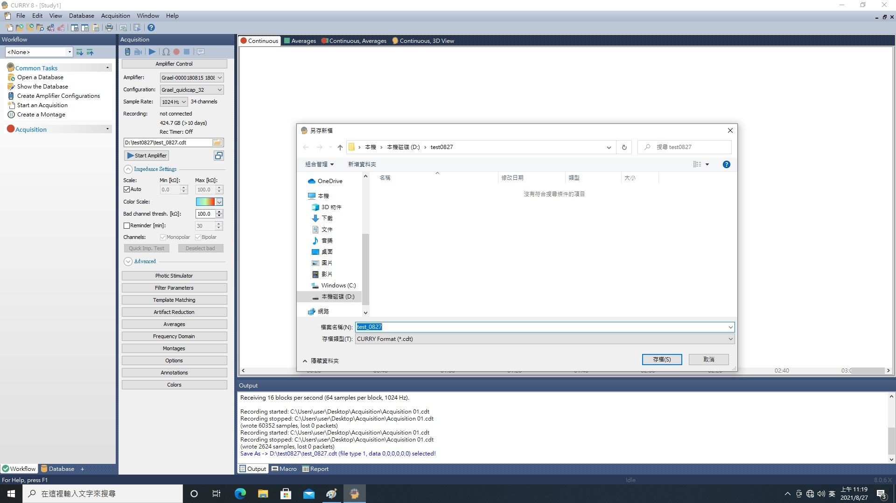
Give the recording session an appropriate name

Slide 24
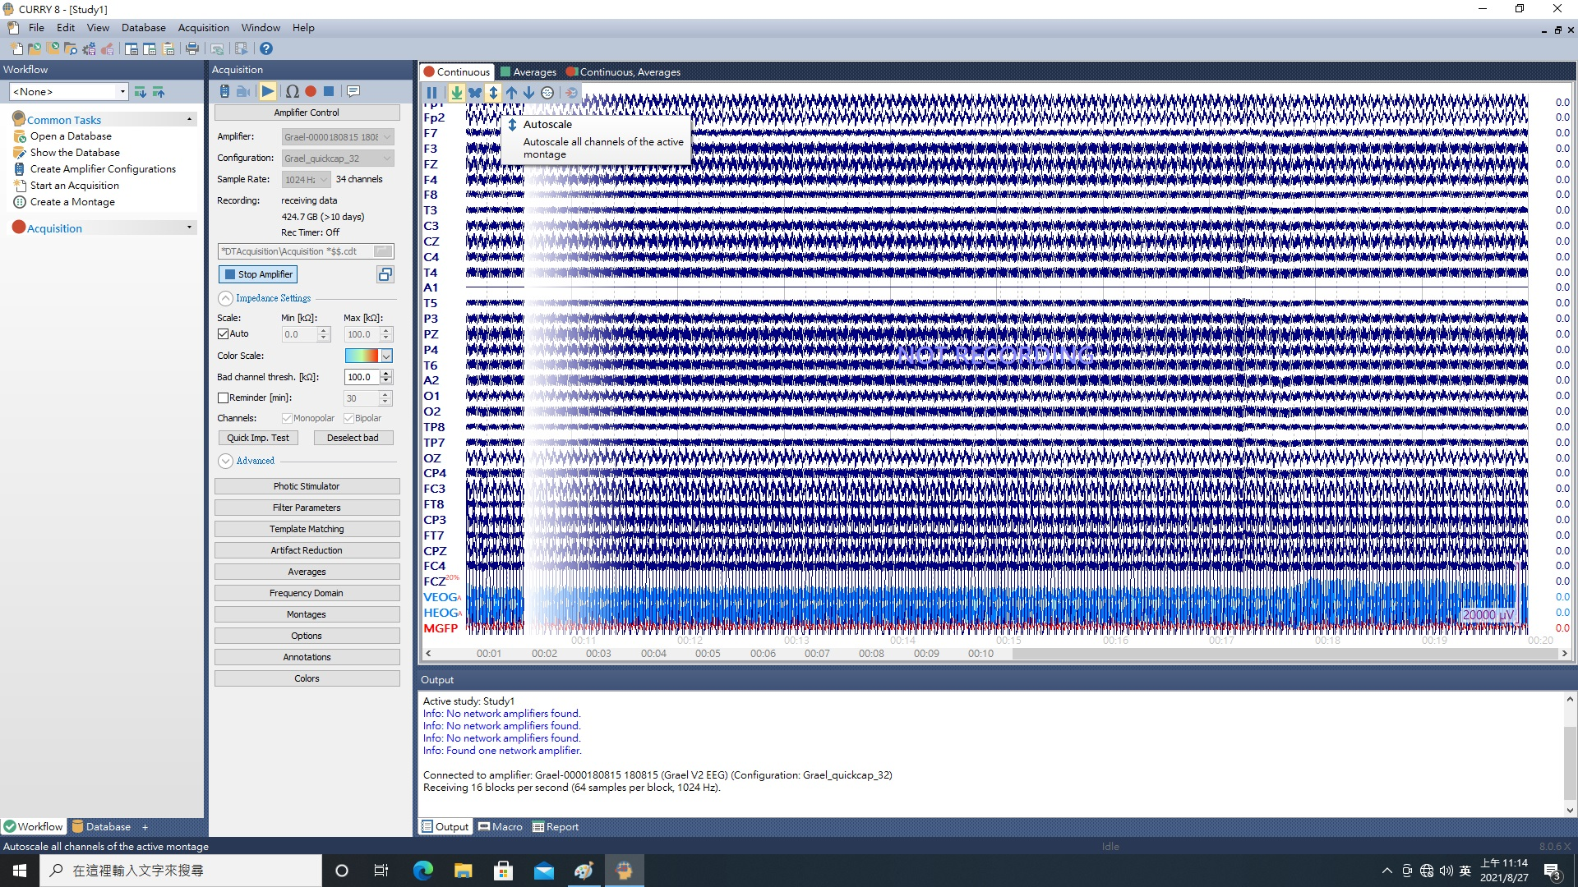
Begin the data acquisition once all the settings are in place.

Slide 25
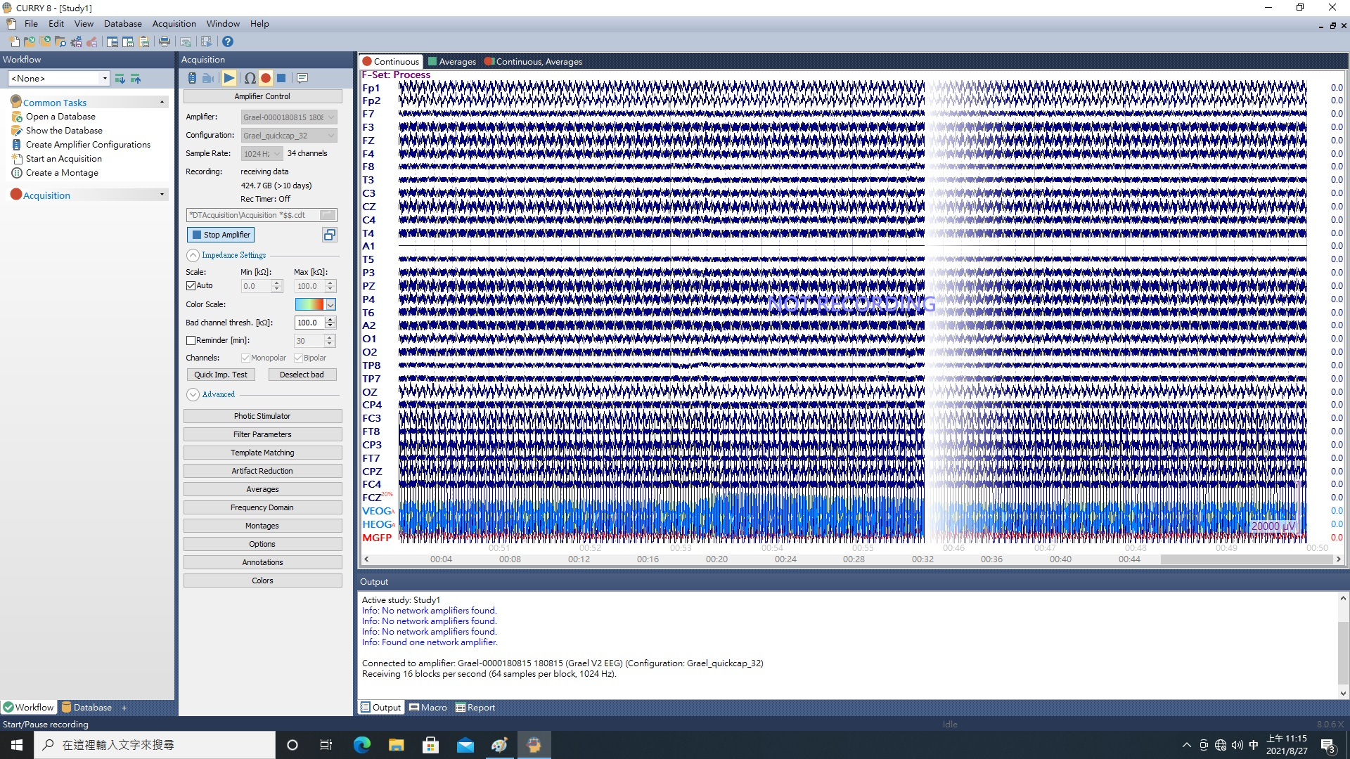
Begin the data acquisition once all the settings are in place.

